Slide 1


Building an Interactive Slack Bot
Notes:
Good afternoon!
Welcome to my talk on Building an Interactive Slack Bot!

Slide 2

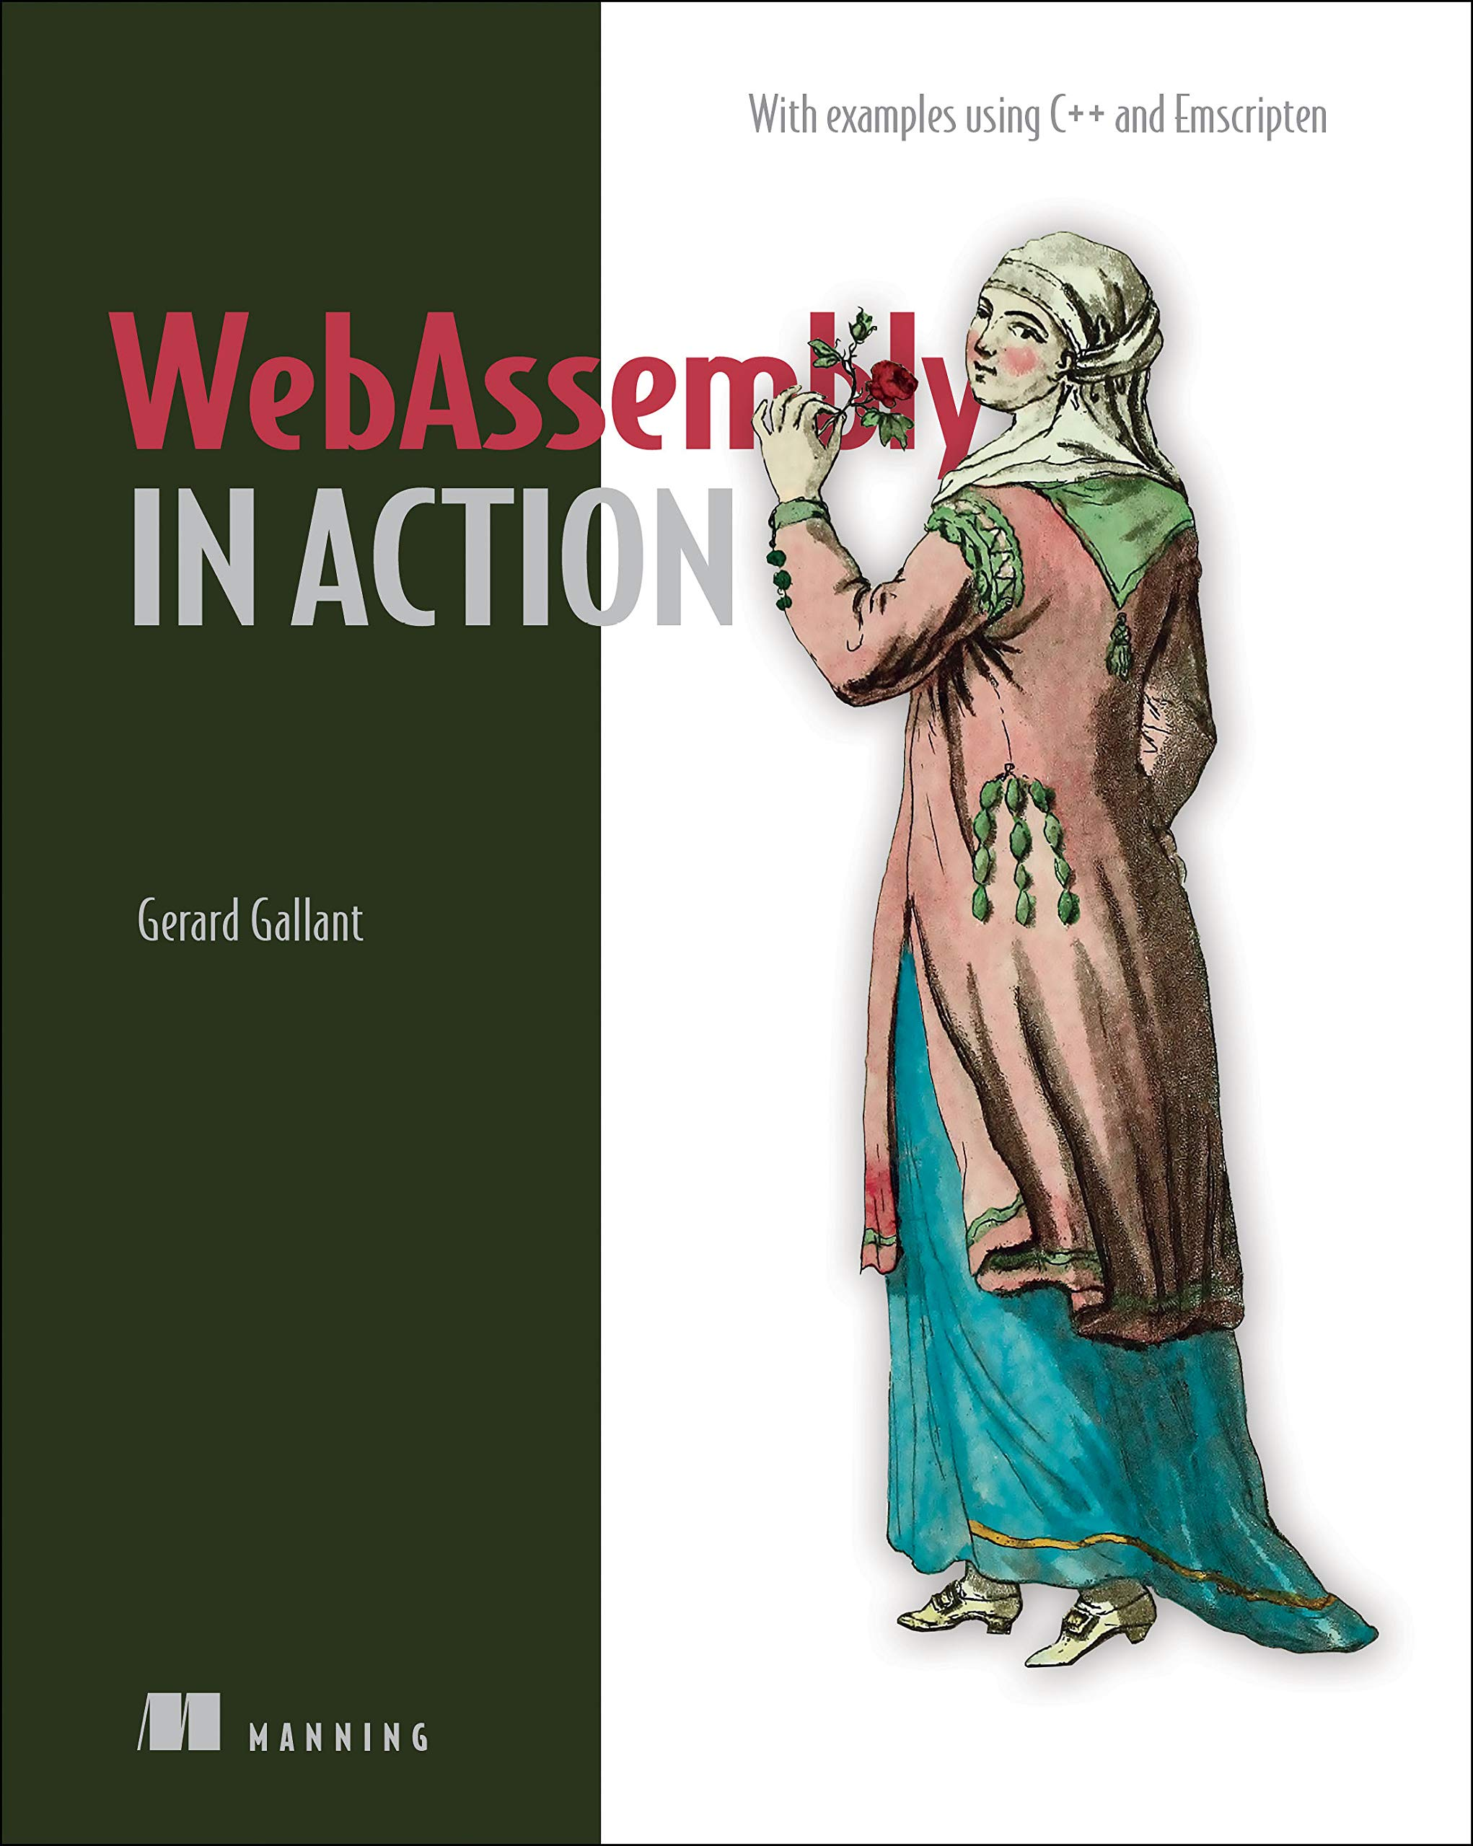


Gerard Gallant
CIO at Dovico Software
“WebAssembly in Action”
http://bit.ly/37zJbp5
@Gerard_Gallant
linkedin.com/in/gerard-gallant
Notes:
My name is Gerard Gallant.
I work at Dovico Software and currently wear a few hats.
CIO is a role that I’m expanding into but I’m also a senior software developer and architect.
Totally unrelated to this talk… I had wanted to write a book since I was a child and was recently given the opportunity by Manning Publications to write a book about WebAssembly called “WebAssembly in Action”.
If you want to reach me, you can find me on Twitter or LinkedIn.

Slide 3


Outline
View the message
Create the bot
Slack API
Bolt for JavaScript
Notes:
When Covid hit we all went home for what we thought was going to be two weeks. We thought the pandemic would be over after that point and life would go back to normal.
Two weeks became many more weeks and, when restrictions were finally lifted, most of us were content with working from home. We had a setup that worked for us, we had our routines, saving money, time and less stress with no more commutes and so on.
As a company, it didn’t make sense to keep renting out a large section of an office building’s floor if very few people were coming into the office so we decided to buy our own building.
The new building was smaller so it didn’t have enough desks if everyone wanted to come in at the same time.
We needed a way to reserve a desk so that people didn’t make a drive in only to find out there was no room.
At the same time, I couldn’t justify paying a monthly fee for an app when all we needed to do was say that we wanted a particular desk so I started looking around at what we were already using for tools to see if there was an opportunity there.
I decided to try using Slack for our desk booking.
I started out with a poll and then, as we got things set up at the office and the number of desks available grew, I switched to a post with multiple messages were staff could add an emoji to the desk message they wanted to reserve.
In the end, I wanted to automate the posting of the message so that I would have to do it manually every day and that’s when I looked into creating a Slack bot which we’ll talk about today.
[click for bullet 1]
For this talk, the first thing we’ll do is take a quick look at the Slack message we’re going to create and interact with.
[click for bullet 2]
Then we’re going to jump into setting up an app in Slack and building the code.
[click for bullets 3 & 4]
For the code, we’re going to leverage Slack’s Bolt for JavaScript SDK
[Switch to Slack and show 3rd-apprach channel]

Slide 4

35% off everything (the code expires on April 21st)
https://github.com/cggallant/confoo-2023

